Slide 1
Training for FDs:
Defenses for Firefighters
Illinois Department of Labor
Division of Occupational Safety and Health V7
Notes:
This training is designed to be delivered by FDs to members. Please reach out to IL OSHA at DOL.Safety@illinois.gov if you have any questions.

Slide 2
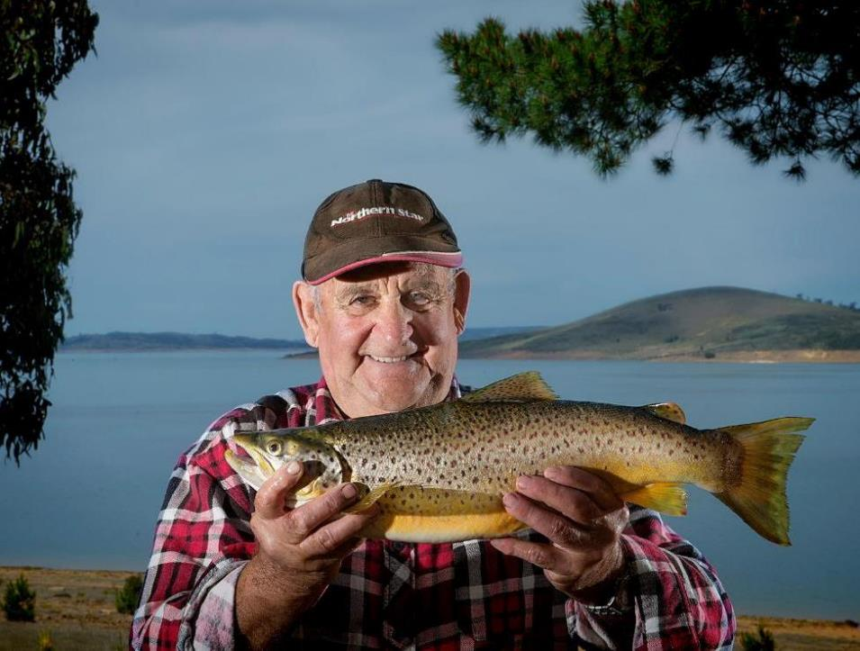
ILLINOIS OSHA
Notes:
This is Bob the firefighter. Bob served his community for 25 years. He had a safe & healthy career and now he can go fishing with his grandkids. Thank you Bob. That’s IL OSHA’s goal: firefighters have a safe and healthy career so they can become grandpas and grandmas.

Slide 3
US
THEM
ILLINOIS OSHA
Notes:
FDs have a goal conflict. They need to achieve firefighter safety (US) AND operational effectiveness (THEM, the public). This is more complex than IL OSHA’s single goal of firefighter safety. Some firefighters/FDs have a mindset focused on firefighter safety (all about us) while some have a mindset focused on the public (all about them). However, we should recognize that there is alternative to this all or nothing mindset.

Slide 4
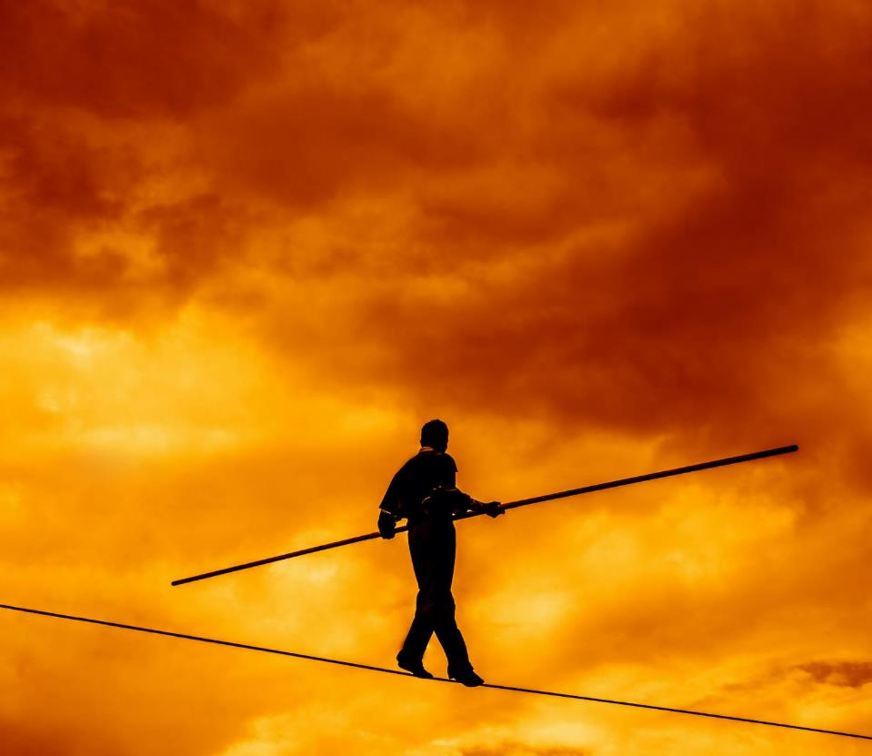
STRIKE THE BALANCE
OPERATIONAL
EFFECTIVENESS
FIREFIGHTER
SAFETY
ILLINOIS OSHA
Notes:
This is not a win/lose, all/nothing, black/white proposition. The goal of FDs and firefighters should be to provide a service that STRIKES THE BALANCE between firefighter safety and operational effectiveness.

Slide 5
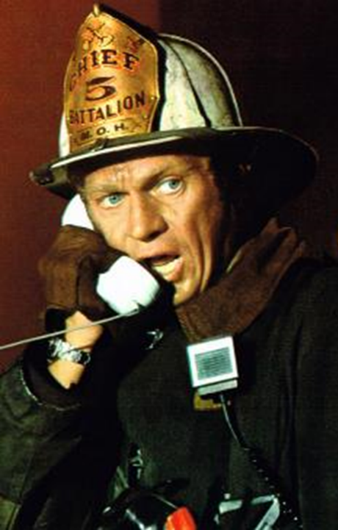
Bottom Line
You are legally required to work safely.
IL OSHA has identified lessons from LODDs.
Learn & apply these lessons.
Strike the balance.
ILLINOIS OSHA
Notes:
Bottom line up front. The Illinois Occupational Safety and Health Act requires public employers (FDs) to comply with occupational safety and health regulations, but it ALSO requires public employees (FFs) to do the same.

Slide 6
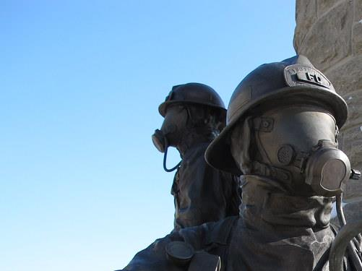
Brian Munz collapse
William Miller crash
Christopher Wheatley fall
Edward Stringer collapse
Corey Ankum collapse
Kurt Meusel crash
Brian Carey flashover
Corey Shaw collapse
Herbert Johnson fire gasses
Timothy Jansen struck by vehicle
Lawrence Stone vehicle crash
Christopher Brown struck by vehicle
Kenneth Lehr struck by apparatus
Daniel Capuano fall
Juan Bucio diving incident
Kody Vanfossan out of air
Jacob Ringering collapse
Dylan Cunningham diving incident
Garrett Ramos collapse, out of air
MaShawn Plummer out of air
Mehdi Mourad vehicle crash
Jermaine Pelt cardiac during fire
Jan Tchoryk cardiac during fire
Kevin Ward out of air
Andrew Price fall
IL LODDs
2008-2023
*Excludes COVID-19 and off
scene cardiac/illness
ILLINOIS OSHA
Notes:
25 names. These are occupationally-related fatalities per IL OSHA determinations. Other determinations (worker’s compensation, pension, LODD benefits, other state laws) may have different criteria for classifying LODDs.

Slide 7
Are we learning from the fallen?
ILLINOIS OSHA
Notes:
IL OSHA asked this question and the assessment was largely no, the fire service has not learned lessons from past LODDs. No one was PUSHING them out. You could PULL from NIOSH, or articles, word of mouth, industry magazines, but you had to go look. IL OSHA is dedicated to PUSHING these lessons to you.

Slide 8
IL OSHA has identified ways for you to be safe AND effective.
We can’t eliminate all risks at an incident, but we can reduce risks.
ILLINOIS OSHA
Notes:
Safe AND effective (strike the balance) is the goal. It is unreasonable to believe that we can eliminate all risks at an incident (the FD was called because the incident IS dangerous). However, we can reduce, control, and mitigate risks.

Slide 9
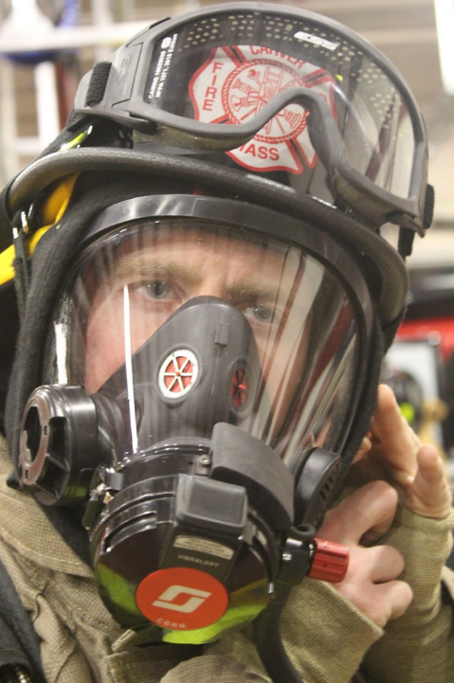
Mindset
ASSESS
Continuously assess risks (lost, trapped, struck…) and defend against them.
Be self-aware, don’t get 100% task oriented.
Be self-disciplined, follow SOPs and the IAP.
Know & respect your capabilities.
RISKS
DEFEND
ILLINOIS OSHA
Notes:
FDs and FFs need to embrace a mindset focused on risks. Assess risks. Defend against those risks. And then continually do that throughout the incident.
FFs, especially when operating outside of direct supervision, must avoid getting so focused that they become 100% task-level oriented and become unaware of the changing risks and situation around them.
FFs must know what they are mentally and physically capable of doing and respect those limitations. Be realistic.
FFs must practice self-discipline and act within FD SOPs and the incident action plan.

Slide 10
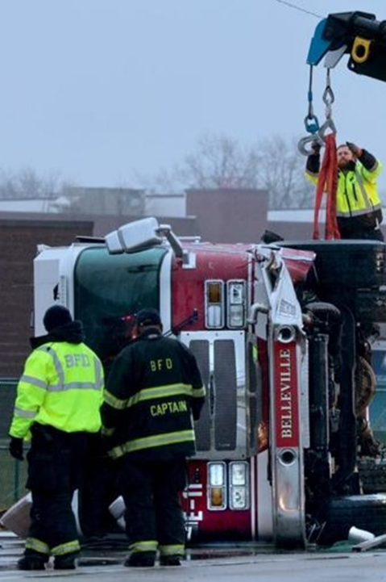
Defenses
STRUCK
Drive to arrive alive.
Seat belt. 100%.
Be visible to drivers when on foot.
Be aware of traffic.
INJURED
ILLINOIS OSHA
Notes:
Seven of the 25 LODDs previously listed involved vehicles. The defenses on the left reduce the risks on the right.

Slide 11
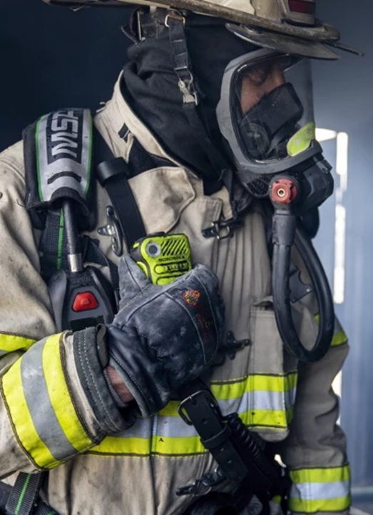
Defenses
LOST
Don’t enter a structure fire without a radio.
Perform radio check prior to entry.
OUT OF AIR
TRAPPED
ILLINOIS OSHA
Notes:
These defenses reduce these risks. Goal is to AVOID the mayday. These defenses also reduce the risk of injury or death AFTER the mayday.
Your radio is your connection to the outside.

Slide 12
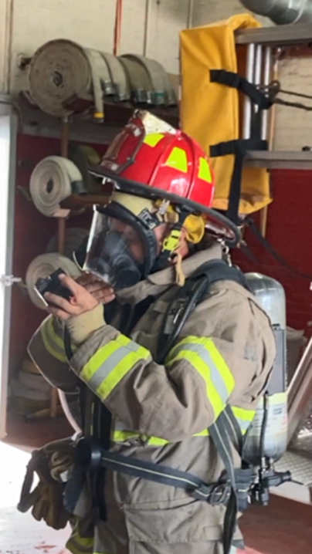
Defenses
OUT OF AIR
Use your equipment.
Know your equipment.
“Walk the walk.”
When asked to go “on air” during an IL OSHA inspection, 10-15% of firefighters FAIL.
BURNED
MALFUNCTION
ILLINOIS OSHA
Notes:
You can’t be safe or effective if you don’t use and know your equipment.
IL OSHA regulations require FDs to train interior firefighters at least quarterly (once every three months). This means interior firefighters are donning their bunker gear, SCBA, and training “on air.”
This is a photo of a firefighter during an IL OSHA inspection. The firefighter was asked to don PPE and go “on air” to demonstrate proficiency. The firefighter forgot his hood and was unable to attach his regulator to his mask.

Slide 13
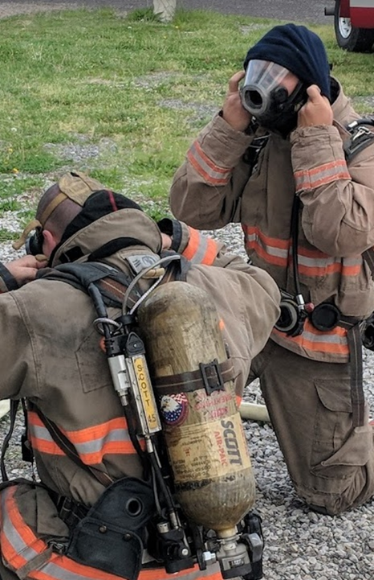
Defenses
TRAPPED
Enter as a team, stay together, exit as a team.
Do not operate alone.
No exceptions?
NO EXCEPTIONS!
INJURED
MALFUNCTION
ILLINOIS OSHA
Notes:
AVOID the mayday. Working alone (outside of voice or visual contact) inside a structure fire is against IL OSHA regulations. Why? Because no one is there to help you if something goes wrong. No tolerance for operating alone.

Slide 14
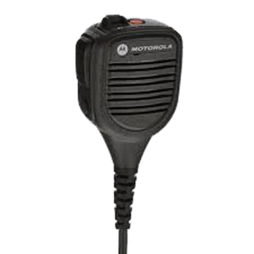
Defenses
TRAPPED
Give command critical info.
“Command from team 3…”
“…there is a basement.”
“…this is a hoarder house.”
“…conditions are getting worse.”
“…electrical line down Charlie side.”
“…fire has extended into the attic.”
BURNED
ILLINOIS OSHA
Notes:
You are the eyes and ears of command. Give command information and help them understand that information so they can defend against risks and develop situational awareness to make decisions.

Slide 15
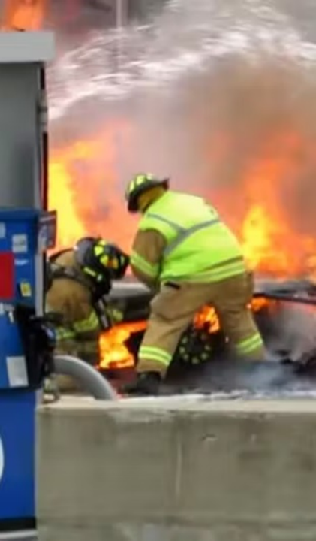
Defenses
STRUCK
BURNED
Buildings FAIL, expect collapse.
Partial vs. complete
Identify basement
Understand the building’s construction and how the fire is affecting it.
TRAPPED
LOST
ILLINOIS OSHA
Notes:
Everyone on the fireground must continually assess for risk of collapse. Check for a basement. Is this fire in the structure or is it a room and contents fire? Is this a balloon-frame house or is it platform construction? How long has this fire been burning? Assess the risk and defend.

Slide 16
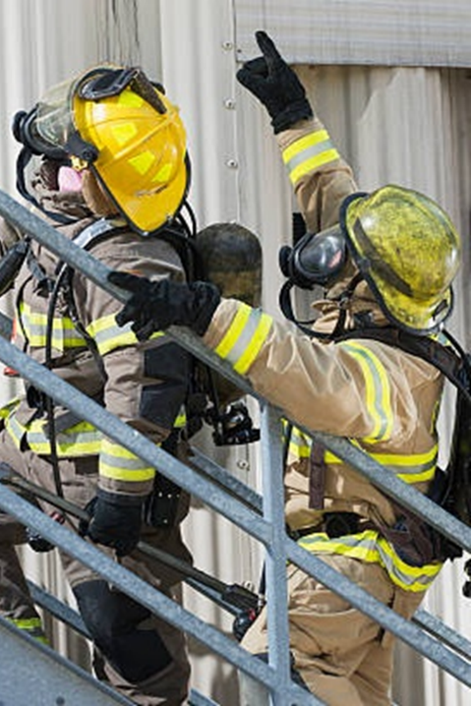
Defenses
BURNED
Speak up if something doesn’t seem right.
Assertive escalation:
1. I’m concerned…
2. I’m uncomfortable…
3. This is unsafe…
STRUCK
TRAPPED
SHOCKED
ILLINOIS OSHA
Notes:
FFs must be assertive and speak up. They are the ones closest to the risks and dangers. Assertive escalation is a recognized way to get the attention of command. If #1 doesn’t work, go to #2, and then #3. If there is an immediate threat/risk, go immediately to #3, “This is unsafe…”

Slide 17
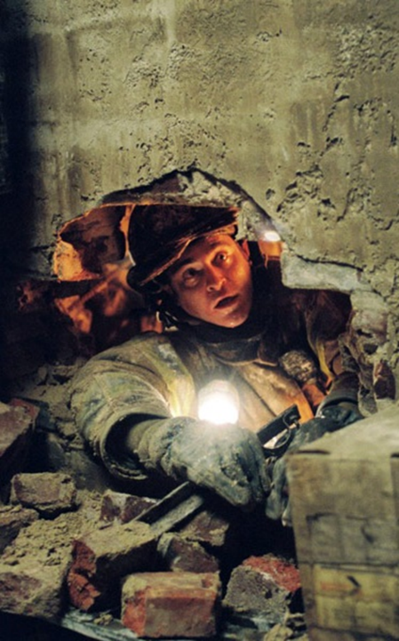
Defenses
LOST
Say your name when calling MAYDAY, repeat until command confirms.
TRAPPED
ILLINOIS OSHA
Notes:
Mayday calls are not always heard clearly. Say your name so that mayday is not A mayday, it is YOUR mayday.

Slide 18
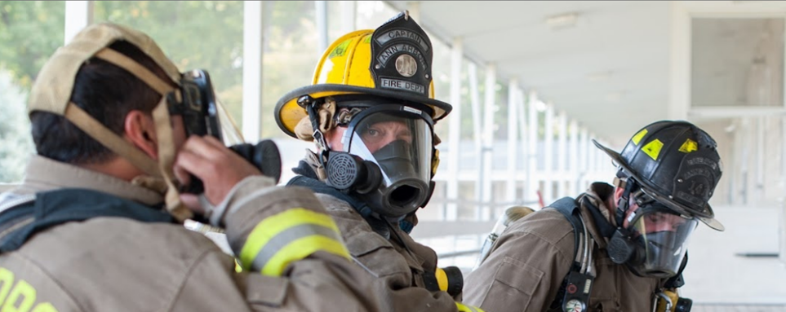
Attend Training
We do not rise to the level of our expectations. We fall to the level of our training.
-Archilochus, Greek Soldier, 650 BC
ASSESS
RISKS
DEFEND
ILLINOIS OSHA
Notes:
Just because you saw something on YouTube does NOT mean you can or should do it. You need to train with your FD and embrace their mindset, their strategies, their tactics. Developing an effective skill set takes training and repetition. Train within your department’s mindset and SOPs.

Slide 19
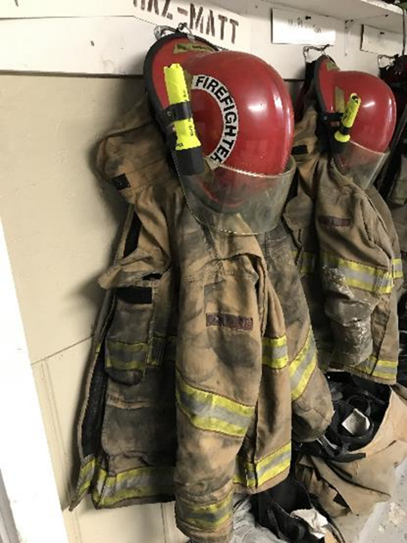
Keep. Your. Gear. Clean.
ILLNESS
ILLINOIS OSHA
Notes:
Ensure initial cleaning/decon on scene of PPE and SCBA and then continue that process at the station to remove contamination and reduce the risk of occupational illness including cancer.

Slide 20
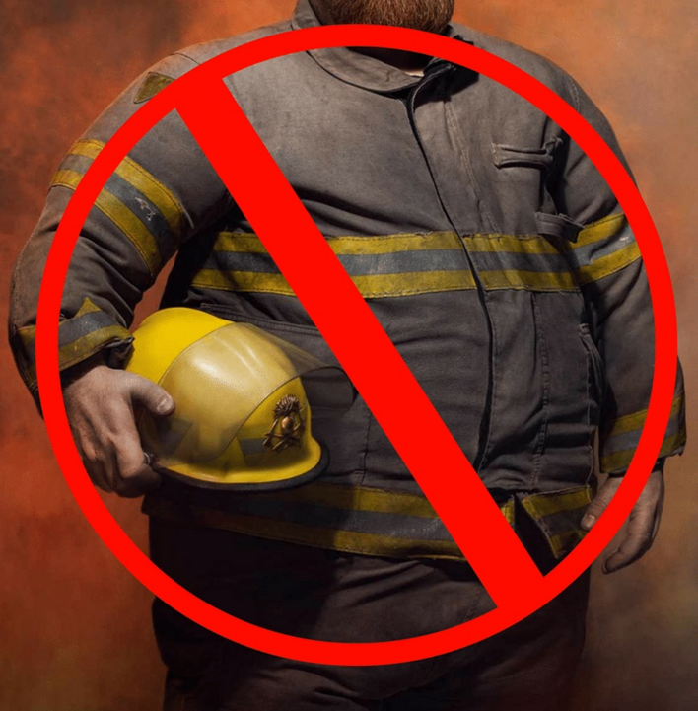
Get fit. Stay fit.
INJURY
ILLNESS
ILLINOIS OSHA
Notes:
You can’t be safe or effective if you are out of shape. Firefighting is a physically demanding job. You owe it to yourself, your fellow FFs, and the public to be physically fit.

Slide 21
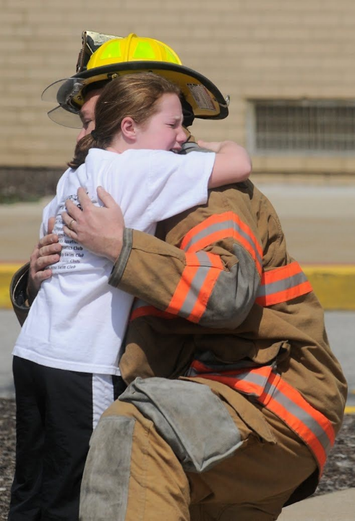
Safety is the ability to have a bad day and walk away from it.
ASSESS
RISKS
DEFEND
ILLINOIS OSHA
Notes:
There are many definitions of safety. For the fire service, consider this one. You should have enough defenses in place so that if something goes wrong you can survive and walk away. We can never expect this to be a zero injury/fatality job. We can assess and defend against risks to be safe and effective. You can strike the balance.

Slide 22
STRIKE THE BALANCE
osha.Illinois.gov/fire
DOL.Safety@Illinois.gov
The 23(g) State and Local Government Plan is funded by a federal grant which constitutes fifty percent of the overall budget. Fifty percent is financed by State funds.
Notes:
This is IL OSHA’s “one stop shop” for the fire service. It has our publications, laws, incident reports, sample programs, training content and much more. It will be frequently updated so make it part of your knowledge library. Contact us anytime at DOL.Safety@illinois.gov

